Slide 1
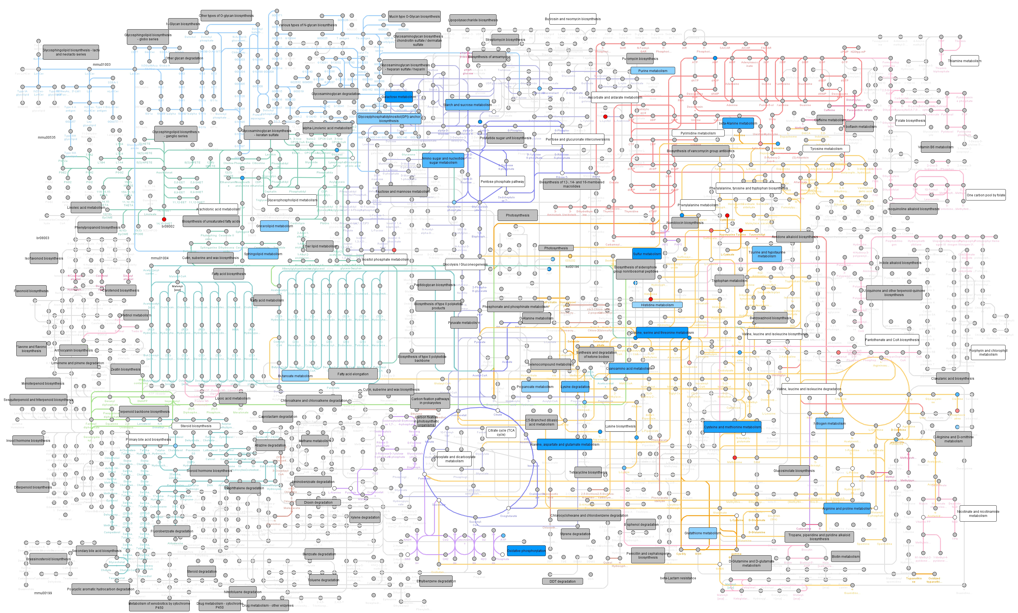
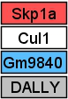
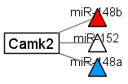
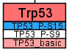
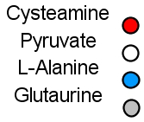
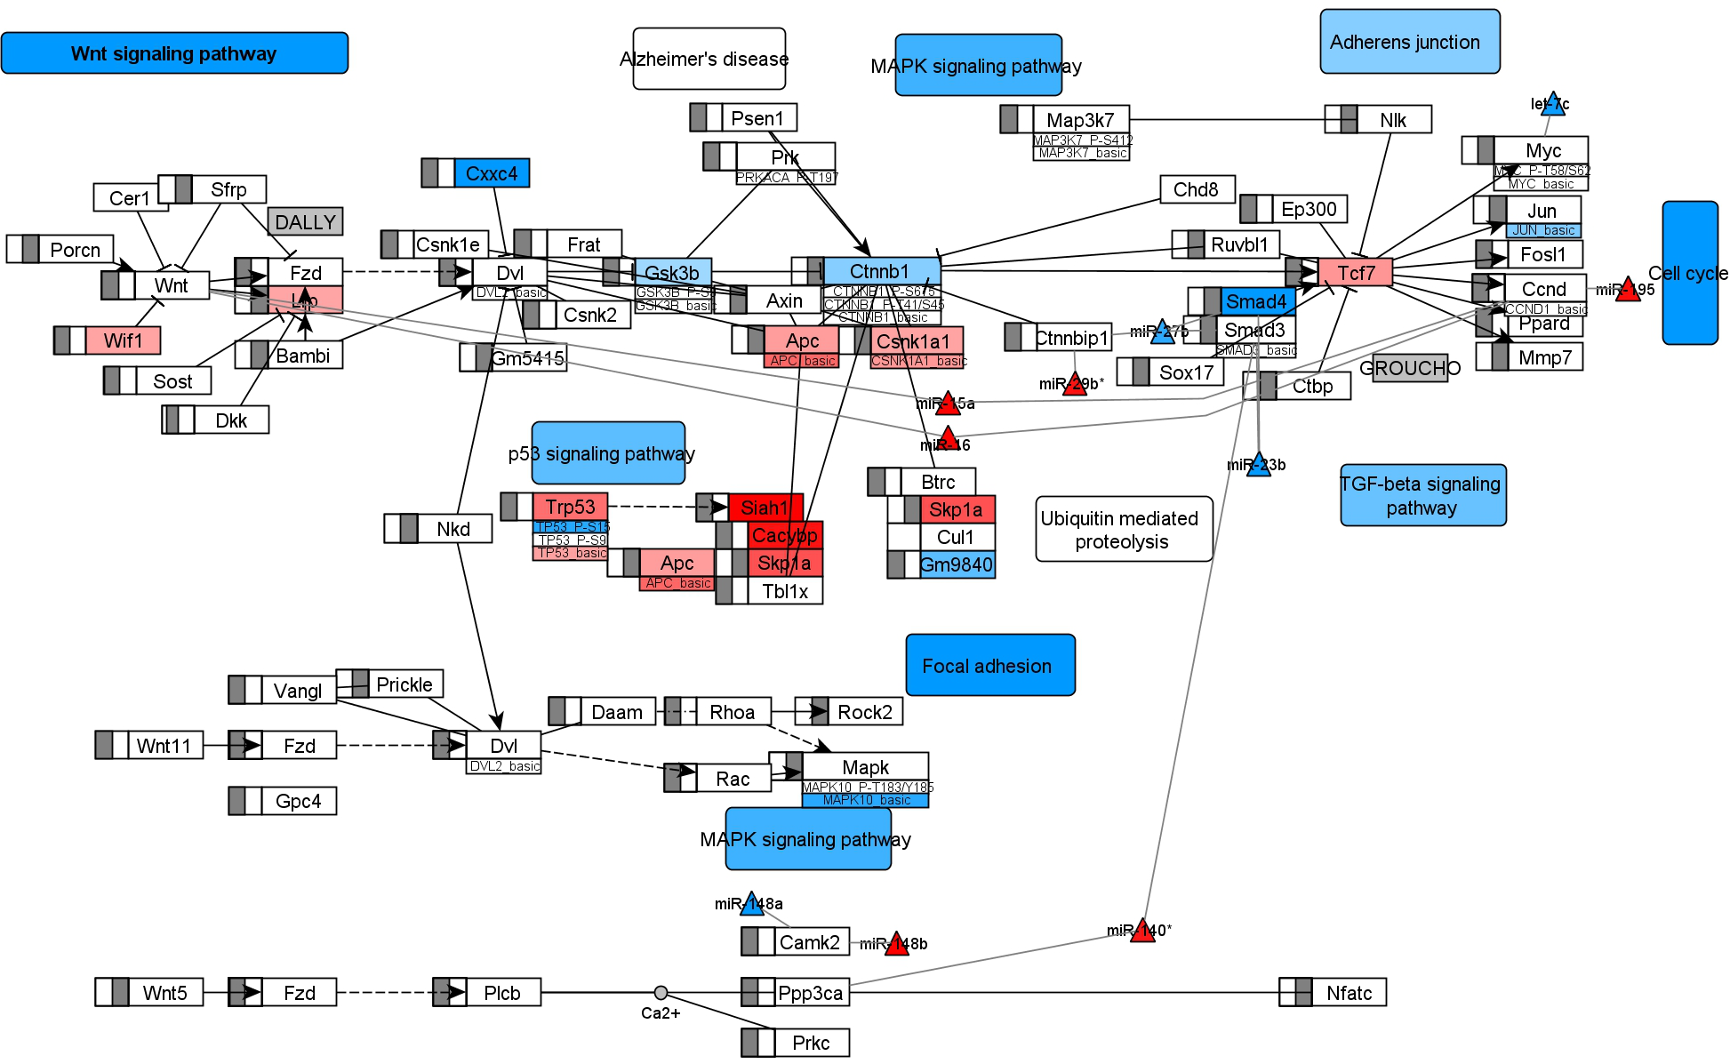
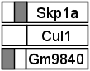
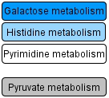
A
Data types
mRNA
miRNA
Protein modification
Metabolite
DNAm
Pathway
Color keys
upregulated
no difference
downregulated
no data
mRNA target
same colors as mRNA
same colors as mRNA
same colors as mRNA
B
hypermethylated
no difference
hypomethylated
high significance
small significance
non significant
contains no significant feature
log₂ fold change (e.g. Metabolite)
-1.5
0
1.5
p-value (e.g. Pathway)
0,0005
0.05

